Slide 1
Craig Kessler, PharmD, Director, Creighton University Medical Center Pharmacy
Caralyn Yamasaki, Hana Griffin, Lauren Moser, Mohammed Alsaigh

Slide 2
Introduction for Craig Kessler, PharmD, RPh
Responsibilities within the Creighton University Medical Center Pharmacy:
Make sure all of the licenses are current
Point of contact for all business aspects of the pharmacy
Hiring and scheduling for pharmacy staff
Review insurance claims to ensure max profits/minimal losses
Ordering drugs for the pharmacy
Make sure projections are met and expenses are within the budget
Being the “Pharmacy Dad”

Slide 3
Issue #1:
Staying Alive and Relevant in a Chain-Driven Industry

Slide 4
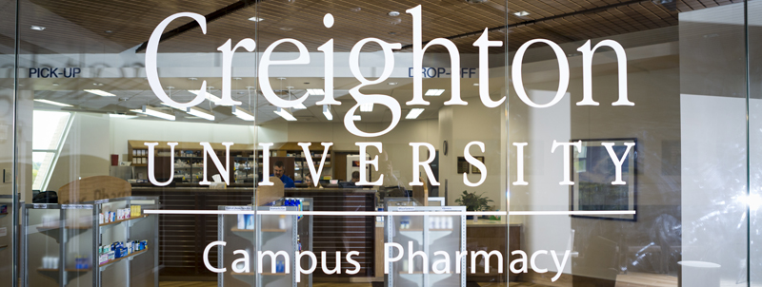

Solutions
Seek new revenue sources through partnerships
Creighton University and CHI
Co-Ops/Buying Groups
Nebraska Pharmacists Association

Slide 5
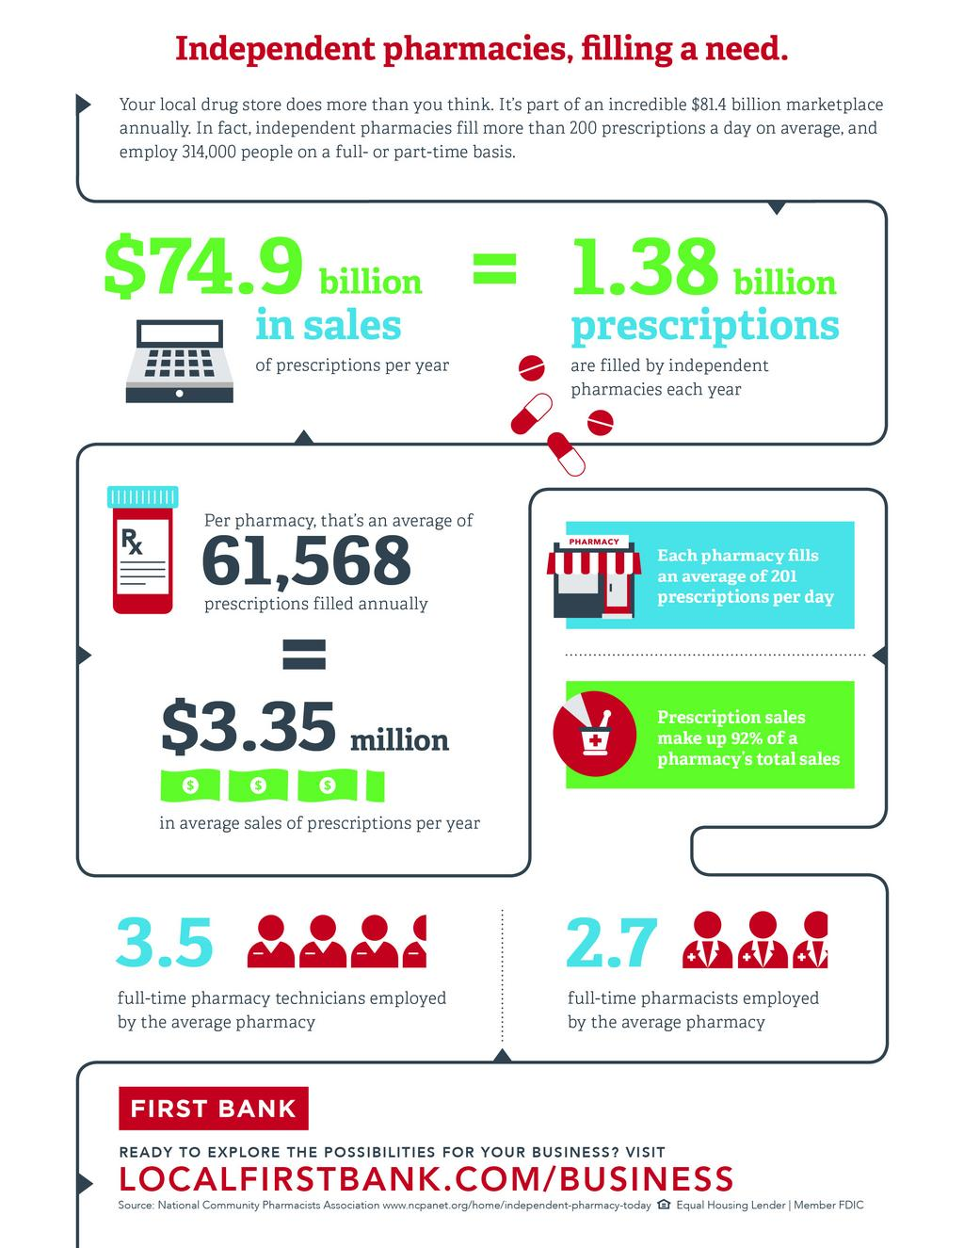
Solutions
Offer services unique to independent pharmacy
Find ways to be convenient
Educate customers
Personalize communication and care
Be a voice in the community

Slide 6
Issue #2:
Keeping Patients Coming Back to Their Pharmacy

Slide 7
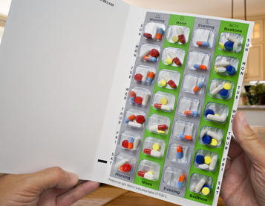

Solutions
Offer additional services
Med-packing
Increases adherence to medications
Interpretive services
Patient counseling for those with limited English
https://medicationpackagingsolutions.com/suremed-7-day-multi-med-card.html
https://www.creativesafetysupply.com/interpretive-services-with-icon-landscape-v2-wall-sign/

Slide 8
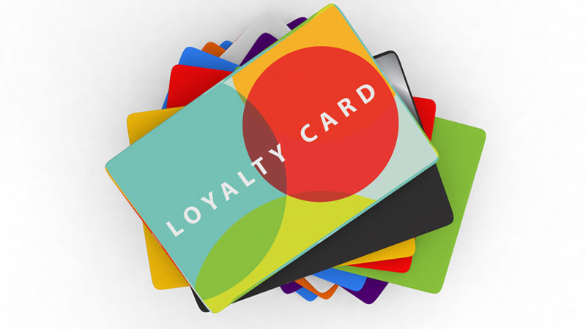
Solutions
Offer Pharmacy Loyalty Programs
Pharmacy cards
Accrue points from purchasing non-prescription drugs, health and wellness products, and pharmaceutical services (Marques et al., 2017)
Exchange accumulated points for all products, excluding prescription drugs
https://www.telusinternational.com/articles/loyalty-programs-drive-customer-loyalty

Slide 9
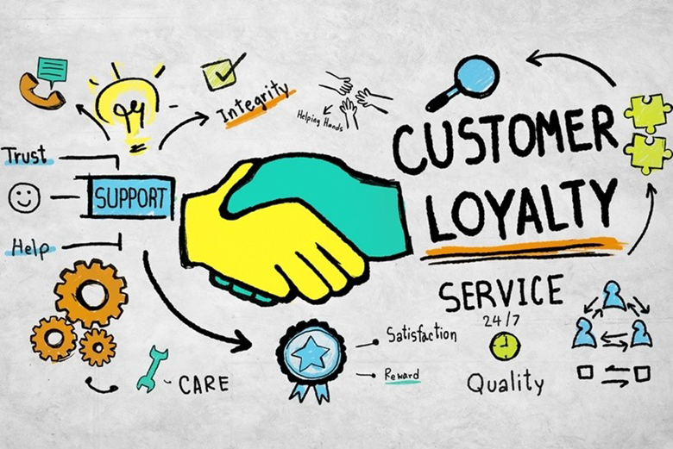
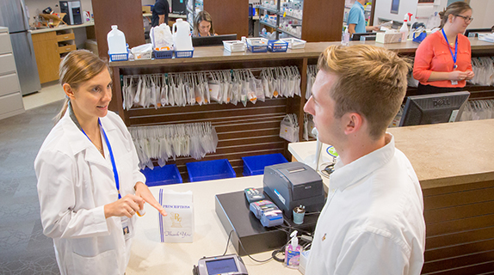
Solutions
Provide quality customer service
Expand pharmacy staff training
Get to know your patients
“Treat your patients as if they were your mother, brother, sister, etc.” -Craig Kessler, PharmD
Don’t treat to make money, treat to improve the health of the patient
https://www.wordstream.com/blog/ws/2016/11/10/customer-loyalty
https://spahp.creighton.edu/

Slide 10
Issue #3:
Finding Ways to Grow the Pharmacy as a Business

Slide 11

Solutions
Increase sales
Place related products nearby
Toothbrush next to toothpaste
Efficient Stocking
Having a good supply of fast-mover medications (most commonly prescribed medications)
http://www.yorkepharmacy.com

Slide 12

Solutions
Customer convenience
Create a Web or Mobile Application
Shopping online
Delivery service
During pandemic
Increase interaction on social media
Social media is the best way to advertise
https://www.raconteur.net/convenience-is-key-in-the-digital-age/

Slide 13
Issue #4:
Poor Reimbursement from Insurance Companies

Slide 14
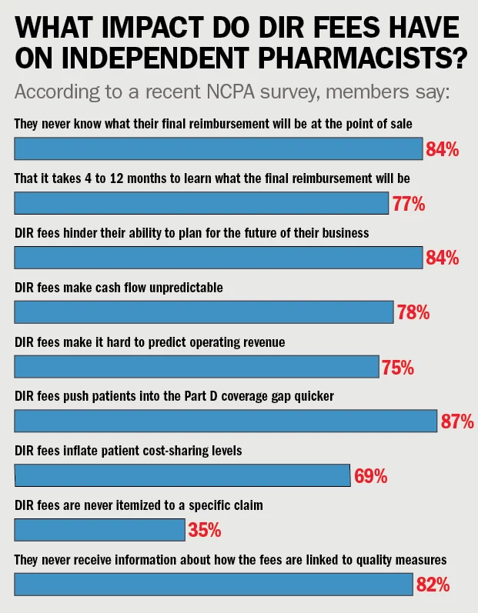
Issue
Insurance reimbursement is decreasing
Losing on 10-15% of prescriptions filled
DIR fees are increasing
Fees that pharmacies are charged, outside of administration fees, that are collected after the point of sale (True North Political Solutions, 2017)
PBM can base fees on performance
Lack of transparency

Slide 15
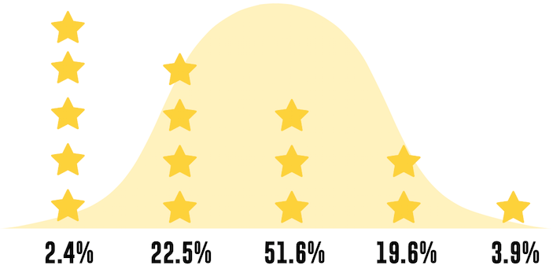
Solutions
Pharmacys binding together against poor reimbursement
Change PBM
Improve star rating given by CMS
Evaluate which medications DIR targets the most
Charge more for prescriptions
https://www.beckershospitalreview.com/quality/rankings-and-reactions-cms-launches-star-ratings-for-hospitals.html

Slide 16
Craig’s advice for those entering Healthcare Management Roles
Be the manager that you’d want to have
Reflect on your past experiences
Who was a good manager? Bad manager?
Explain why things need to be done rather than throwing out commands
Ask, don’t order
Don’t yell at your staff

Slide 17
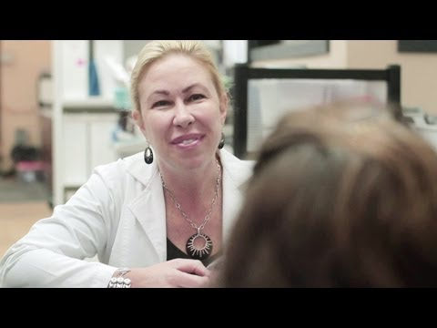
Summary Video (2:29)

Slide 18
Sources
Lyer, K. (2020, July, 20). 7 Ways to Increase Pharmacy Products Sales for Independent Pharmacy Store. Customer Think.
https://customerthink.com/7-ways-to-increase-pharmacy-products-sales-for-independent-pharmacy-store/
Marques, S. H., Cardoso, M. G. M. S., & Lindeza, A. C. A. (2017). Do Loyalty Cards Enhance Loyalty in the Pharmaceutical Sector? Journal of Relationship
Marketing, 16(2), 143–162. https://doi.org/10.1080/15332667.2016.1242398
True North Political Solutions. (2017, October 25). White Paper: DIR Fees Simply Explained. Pharmacy Times.
https://www.pharmacytimes.com/view/white-paper-dir-fees-simply-explained.

